Slide 1

Preliminary Site Selection
Varshini Rana
April 26, 2022
Notes:
We are going to do a market analysis of Chicken Kitchen to determine a site to select for expansion among two counties in the U.S.A. – Oakland County, Michigan and Bay County, Florida.

Slide 2

Image Source: https://unsplash.com/photos/ek6DZptJ_KI
Notes:
Meet the Browns. They stay in the suburbs of Oakland County. They have dual incomes, and each earn six figures with no liabilities, allowing them to support a comfortable and leisure-filled lifestyle. They are always on the lookout for the next fancy hangout spot serving healthy food to support their sophisticated tastes and would definitely not mind paying Chicken Kitchen a visit.

Slide 3

Image Source: https://unsplash.com/photos/ek6DZptJ_KI
Image Source: https://www.pexels.com/photo/couple-practicing-yoga-6787498/
Notes:
Meet the Taylors. These affluent empty nesters of Oakland County pride themselves on being fitness enthusiasts who strictly watch what they eat and maintain an active lifestyle. Having held the top-most positions in their careers, they are now retired and have both, the time, and the money to experience the best things life has to offer. Their refined inclinations would be the perfect fit for Chicken Kitchen’s emphasis of using clean, healthy ingredients in an upscale setting.

Slide 4
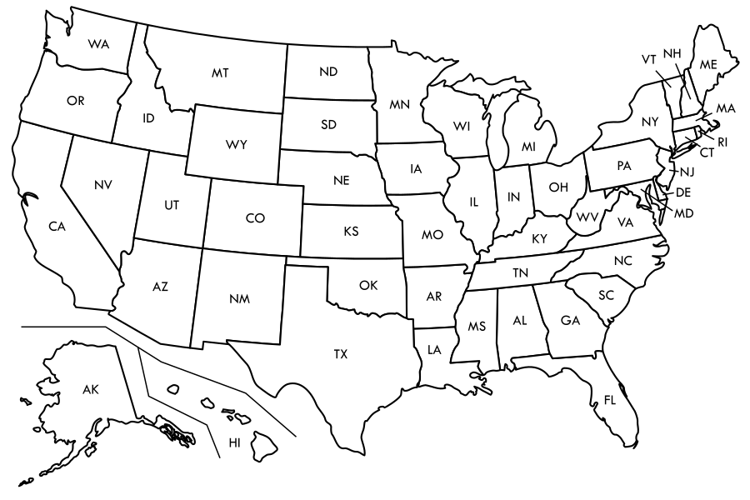
Oakland County, MI
Bay County, FL
Image Source: https://en.wikipedia.org/wiki/File:Blank_US_map_borders_labels.svg
Notes:
That brings us to question: which county do we expand to? We have received applications for expansion into Oakland County, Michigan in the north-east and Bay County, Florida in the south-east.

Slide 5

Oakland County, MI
Image Source: https://oaklandcountyblog.com/things-to-do/independence-day-fireworks/
Notes:
Based on a number of criteria, we think that Oakland County is the right place for Chicken Kitchen expansion. Let us take a closer look at them.

Slide 6
Oakland County’s median household income is ~25% higher than the U.S.A. median
$81,587
Oakland County
$64,994
U.S.A.
Data Source: CensusReporter.org
Notes:
First of all, the median household income in Oakland County is almost 25% higher than the USA median. That’s a lot of disposable income that can be used in eating out!

Slide 7
Oakland County’s median household income is ~25% higher than the U.S.A. median
$81,587
Oakland County
$64,994
U.S.A.
$252,800
$229,800
Oakland County’s median value of housing units is ~10% higher than the U.S.A. median
Oakland County
U.S.A.
The relatively high income and high prices of housing units in Oakland County compared to the U.S.A. points to a fairly affluent and economically-stable consumer base.
Data Source: CensusReporter.org
Notes:
We can also see that the median value of housing units is 10% higher than the USA median, suggesting that homeowners in this county are typically affluent and economically stable, which bodes well for Chicken Kitchen’s consumer base.

Slide 8
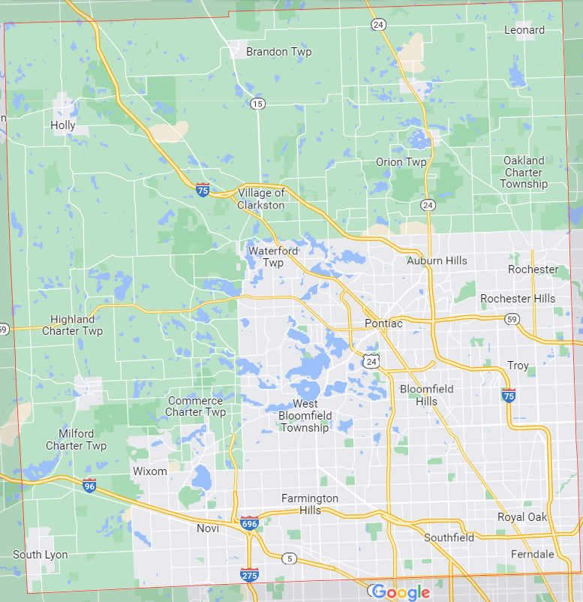
1,270,017
Population
Oakland County is the second-most populous county in Michigan
Data Source: CensusReporter.org, Oakland County Government Services, Chicago Tribune
Image Source: Google Maps
Notes:
With a population of 1.2 million, Oakland County is the second-most populous county in Michigan, which means a significant number of potential Chicken Kitchen consumers.

Slide 9

1,270,017
Population
Oakland County is the second-most populous county in Michigan
Oakland University
Oakland County is home to Oakland University, ensuring a large and steady influx of young people.
Data Source: CensusReporter.org, Oakland County Government Services, Chicago Tribune
Image Source: Google Maps
Notes:
Oakland County is also home to Oakland University, ensuring a large and steady influx of young people who like to eat out all year round.

Slide 10
15 major interstate, numbered, and trunkline highways pass through Oakland County
1,270,017
Population
Oakland County is the second-most populous county in Michigan
Oakland University
Oakland County is home to Oakland University, ensuring a large and steady influx of young people.
The longer on the road, the more likely drivers are to want a quick and easy stop for food.
Data Source: CensusReporter.org, Oakland County Government Services, Chicago Tribune
Image Source: Google Maps
Notes:
Moreover, Oakland County has as many as 15 major numbered and trunkline highways passing through it, 7 of which are interstate, offering good accessibility to surrounding states. The longer on the road, the more likely drivers are to want a quick and easy stop for food and that’s where Chicken Kitchen can step in.

Slide 11
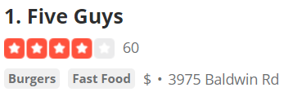
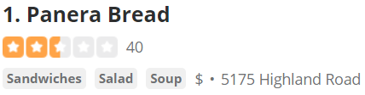
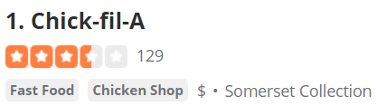
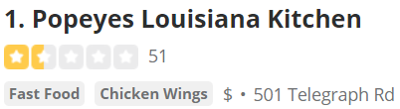
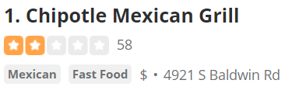
The market is pre-primed for Chicken Kitchen expansion.
Image Source: Google Maps, Yelp
Notes:
When we look at who’s already in Oakland County, we see a lot of our organizations who have similar business models to Chicken Kitchen, suggesting a market that is pre-primed for expansion.

Slide 12
County | Population estimate | Median household income ($) | Housing growth last 21 years (%) | Interstates | Population below poverty line (%) | Competitors | Republican (%)
Oakland, MI | ~1.28 million | ~81,000 | ~10 | 7 | ~7 | Mid-level | ~44
Bay, FL | ~171 thousand | ~56,000 | ~36 | 1 | 13 | Budget-level | ~70
Data Source: Gale Business DemographicsNow, CensusReporter.org, U.S. Census Bureau
Bay County, FL comes up short compared to Oakland County, MI on several criteria.
Oakland County, MI
Households by Income greater than $100,000 (in percent)
Bay County, FL
Data Source: Gale Business DemographicsNow
Notes:
So, why didn’t we choose Bay County, Florida? It turns out that Bay County fails several of these criteria that we put forth for Chicken Kitchen profits. While the housing growth and the population that consistently votes Republican is significant, that does nothing to balance out the other factors, such as lower population, lower income, greater poverty rate, no interstate connectivity, and the lack of existing upscale fast-casual options, making expansion into this county an unknown terrain. Additionally, we can also see that the gap between households earning 6 figures between both the counties is significant, with projections showing an increase in the case of Oakland County, and remaining stagnant for Bay County, making it an unfavorable location for Chicken Kitchen expansion.

Slide 13

Action Steps
1. Conduct focus group discussions
Obtain consumer feedback! Is Chicken Kitchen going to be well-received in this community?
2. Initiate real estate discussions
Initiate discussions on availability and costs associated with land and personnel in college cities such as Rochester Hills.
3. Research on other fast-casual competitors
Is the market saturated? How are our competitors doing?
A
N
O
I
T
C
A
Notes:
Based on this analysis, the next steps should be to conduct focus group discussions for determining whether Chicken Kitchen would be well-received in Oakland County, to initiate discussions for availability and costs of land and personnel in college towns within the county, and to conduct a thorough research into the competitors within the county in order to determine whether the market is saturated.

Slide 14
All ways, moving forward…
Image Source: https://unsplash.com/photos/ek6DZptJ_KI
Image Source: https://www.pexels.com/photo/couple-practicing-yoga-6787498/
Notes:
So, if folks like the Browns and Taylors are on the lookout for fresh food in an upscale setting, we believe that Chicken Kitchen is exactly what they’re looking for! With that in mind, I encourage you to move forward with the application of Oakland County, just as Oakland’s tagline says: “All ways, moving forward”.

Slide 15
References
“American Community Survey”. 2020. Census Reporter: Making Census Data Easy to Use. https://censusreporter.org/
“U.S. Census Bureau QuickFacts: Oakland County”. 2021. The United States Census Bureau. https://www.census.gov/quickfacts/oaklandcountymichigan
“U.S. Census Bureau QuickFacts: Bay County”. 2021. The United States Census Bureau. https://www.census.gov/quickfacts/baycountyflorida
“Oakland County, MI”. 2021. Gale Business: DemographicsNow. https://www.gale.com/c/business-demographicsnow
“Bay County, FL”. 2021. Gale Business: DemographicsNow. https://www.gale.com/c/business-demographicsnow
“Oakland County, Michigan”. 2021. Oakland County, Michigan Government Services. https://www.oakgov.com/Pages/default.aspx
“Yelp”. 2022. Yelp. https://www.yelp.com
“Google Maps”. 2022. Google Maps. https://www.google.com/maps
“How the Midwest's suburbs and highways gave rise to today's fast food giants”. 2018. Chicago Tribune. https://www.chicagotribune.com/dining/ct-food-fast-food-midwest-20180725-story.html

